Slide 1
Radiation Dose to Patients from Radiopharmaceuticals
ICRP Publication 128
Authors:
S. MATTSSON (chairman), L. JOHANSSON, S. LEIDE SVEGBORN, J. LINIECKI,
D. NOßKE, K.Å . RIKLUND, M. STABIN, D. TAYLOR, W. BOLCH, S. CARLSSON,
K. ECKERMAN, A. GIUSSANI, L. SÖDERBERG, S. VALIND
Author for educational slides on behalf of ICRP
M. ANDERSSON

Slide 2
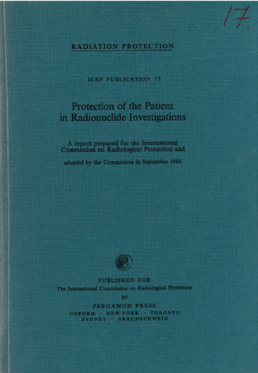
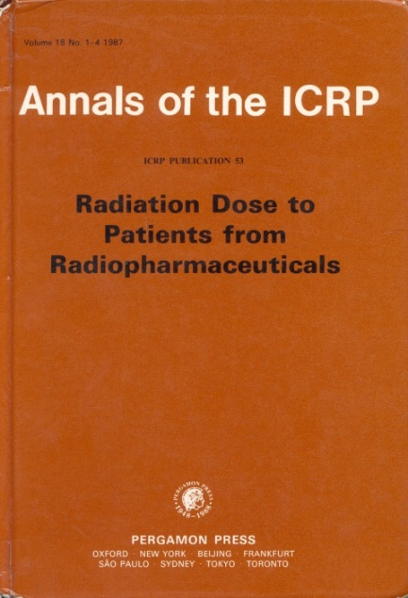
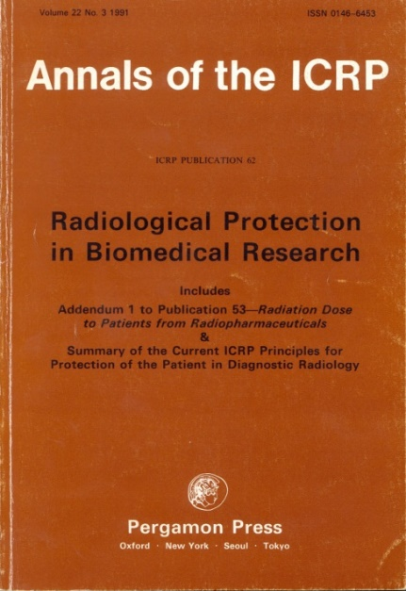
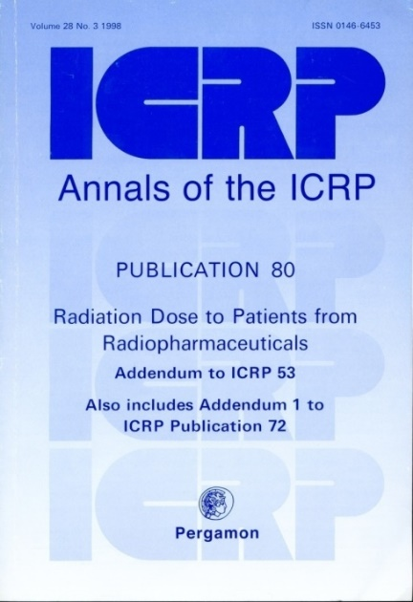
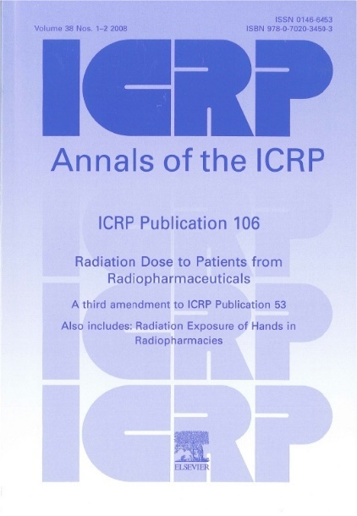
Previous ICRP Publications on
Radiation Dose to Patients from Radiopharmaceuticals
ICRP Publ. 17
ICRP Publ. 53
ICRP Publ. 62
ICRP Publ. 80
ICRP Publ. 106
If you don’t find what you are looking for in Publication 128, please go to Publications 106, 80 or 53.

Slide 3
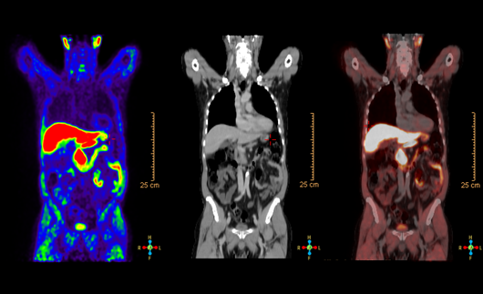
Doctors seek to find a diagnosis
with radiopharmaceuticals
Time window of clinical interest
But what happens with the radiopharmaceutical after the image has been taken?
t
Time window of dosimetric interest

Slide 4
Why is it important to know what happens to the radiopharmaceuticals?
To estimate the absorbed dose to different organs and tissues.
To be able to compare different examination techniques.
To achieve adequate optimisation.

Slide 5
Part 1:Quantification of the activity in organs and tissues at various times after administration
  - Collecting images and calculating activity

Slide 6
Biokinetic & dosimetric studies
Are preferably made on healthy volunteers.
Measurements start at the injection and continue until most of the activity has left the body, either by radioactive decay or by biological elimination.
From all the measurements a biokinetic model is generated (often based on the mean values of the participants).
The biokinetic model is assumed to be valid for a general population.

Slide 7
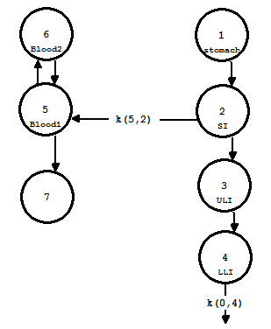
Biokinetic & dosimetric studies
Relevant organs and tissues are outlined
in the images, which are taken at various
times after injection.
In this way it is possible to define time activity curves for the organ and tissues of interest. If enough data are available, a compartment model describing the biokinetics of the radiopharmaceutical is created.
However, in most cases only descriptive models can be created due to limited available information.
An compartmental model.

Slide 8
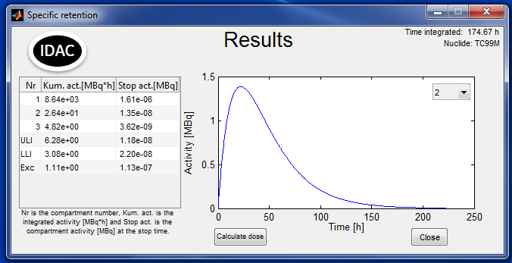
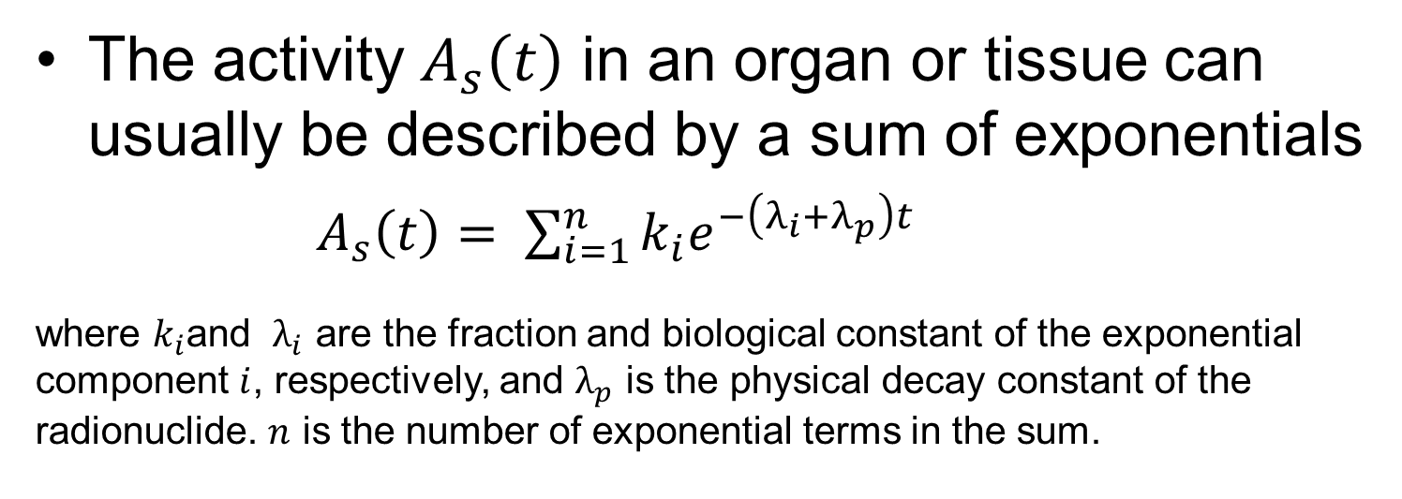
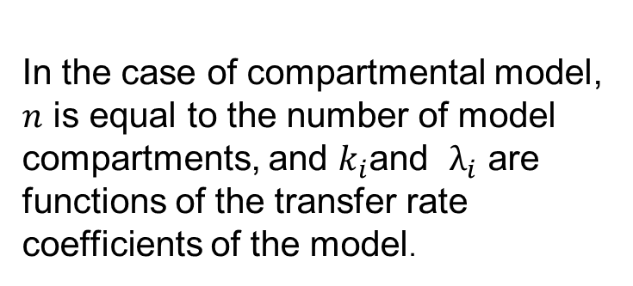
Organ activity over time
The activity $A_{s}\left(t\right)$ in an organ or tissue can usually be described by a sum of exponentials
  $A_{s}\left(t\right)= \sum_{i=1}^{n}{k_{i}e^{−\left(λ_{i}+λ_{p}\right)t} }$
where $k_{i}$and $λ_{i}$ are the fraction and biological constant of the exponential component $i$, respectively, and $λ_{p}$ is the physical decay constant of the radionuclide. $n$ is the number of exponential terms in the sum.
In the case of a compartmental model, $n$ is equal to the number of model compartments, and $k_{i}$and $λ_{i}$ are functions of the transfer rate coefficients of the model.

Slide 9
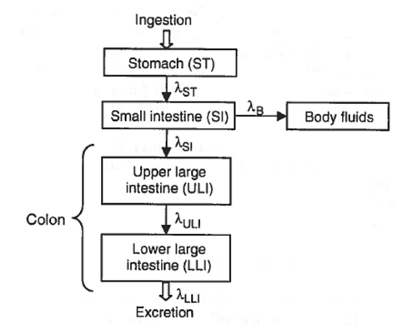
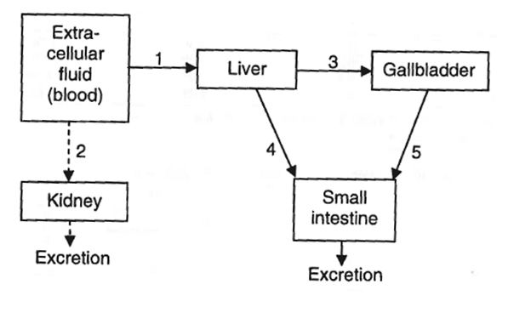
Compartmental modelling
ICRP has a number of standardised models for different parts of the body.
ICRP Publ. 30 GI-tract model
ICRP Publ. 53 Liver and biliary excretion model

Slide 10
Compartmental modelling
The most commonly used of ICRP models is the kidney-bladder model.
It is an age-specific model, since the time between successive voidings of the bladder (voiding interval) depends on the age of the patient: newborn, 1 year, 5 years, 10 years, 15 years and adult.

Slide 11
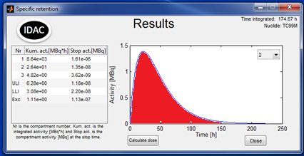

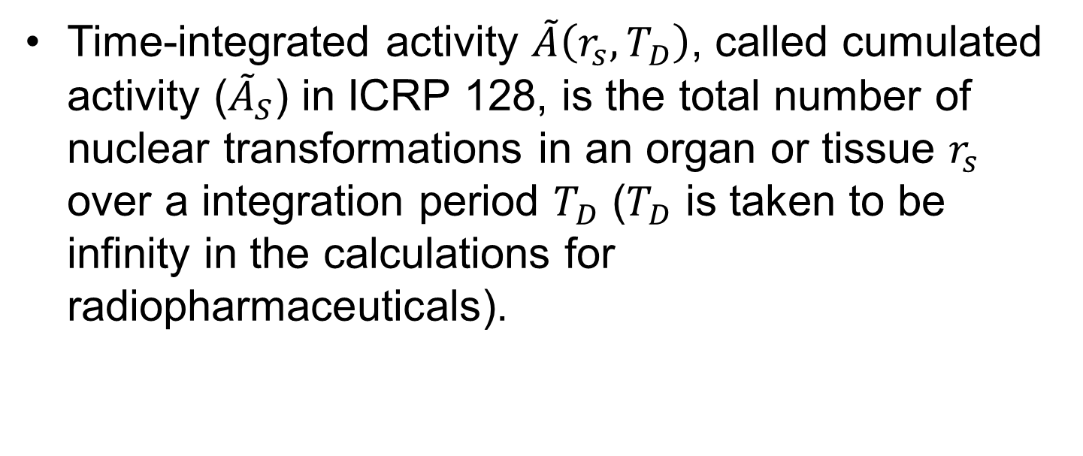
Time-integrated activity in source region S
Time-integrated activity $\tilde{A}\left(r_{s},T_{D}\right)$, called cumulated activity (${\tilde{A}}_{S}$) in ICRP 128, is the total number of nuclear transformations in an organ or tissue $r_{s}$ over a integration period $T_{D}$ ($T_{D}$ is taken to be infinity in the calculations for radiopharmaceuticals).

Slide 12
Recap - what have we done?
Measurements on healthy volunteers.
Identify relevant organ and tissue and calculate the mean transfer rates between compartments.
Create a simplified biokinetic model of the radiopharmaceutical (not necessarily physiologically correct).
Calculate the cumulated activity for the relevant organs and tissue.

Slide 13
Part 2: Phantoms, absorbed dose to organs/tissues and effective dose
- Risk estimations and S-values

Slide 14
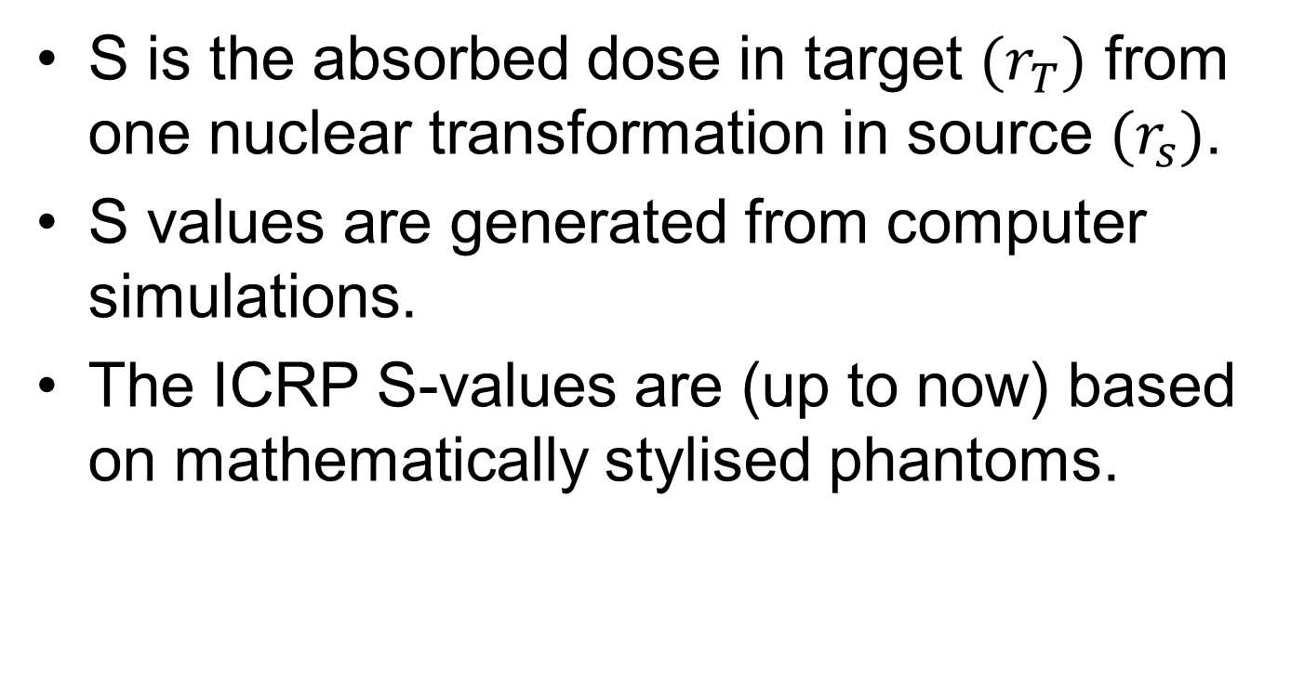
The quantity S
S is the absorbed dose in target $(r_{T})$ from one nuclear transformation in source $(r_{s})$.
S values are generated from computer simulations.
The ICRP S-values are (up to now) based on mathematically stylised phantoms.

Slide 15
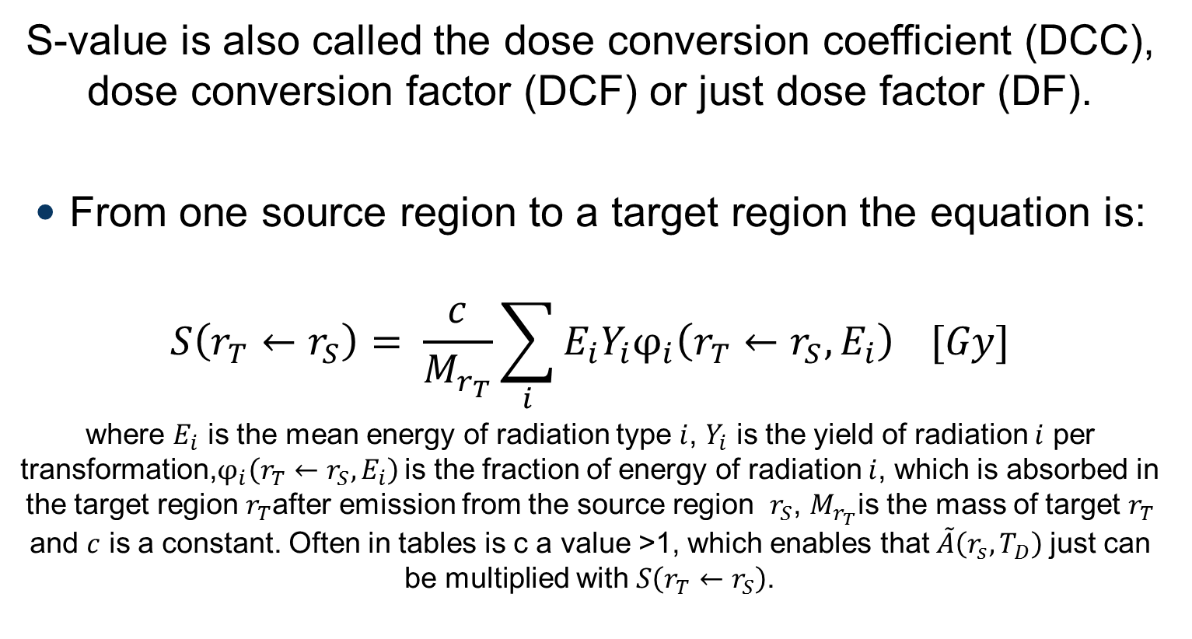
“We have many names for the things we love”
S-value is also called the dose conversion coefficient (DCC), dose conversion factor (DCF) or just dose factor (DF).
From one source region to a target region the equation is:
$$S\left(r_{T}←r_{S}\right)= \frac{c}{M_{r_{T}}}\sum_{i}{E_{i}Y_{i}φ_{i}\left(r_{T}←r_{S},E_{i}\right)} [Gy]$$
where $E_{i}$ is the mean energy of radiation type $i$, $Y_{i}$ is the yield of radiation $i$ per transformation,$φ_{i}\left(r_{T}←r_{S},E_{i}\right)$ is the fraction of energy of radiation $i$, which is absorbed in the target region $r_{T}$after emission from the source region $r_{S}$, $M_{r_{T}}$is the mass of target $r_{T}$ and $c$ is a constant. Often in tables is c a value >1, which enables that$\tilde{A}\left(r_{s},T_{D}\right)$ just can be multiplied with $S\left(r_{T}←r_{S}\right)$.

Slide 16
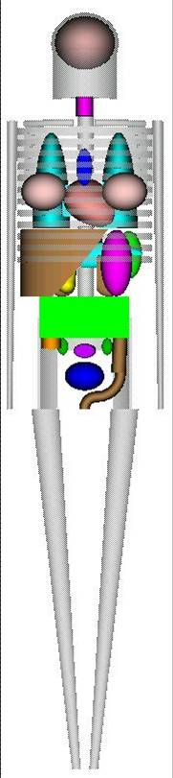
Phantoms
The phantoms currently in use are the mathematical phantom series developed by Cristy & Eckerman (1987).
They are mathematically based on linear and quadratic equations.
Cristy & Eckerman (1987)
Male phantom

Slide 17
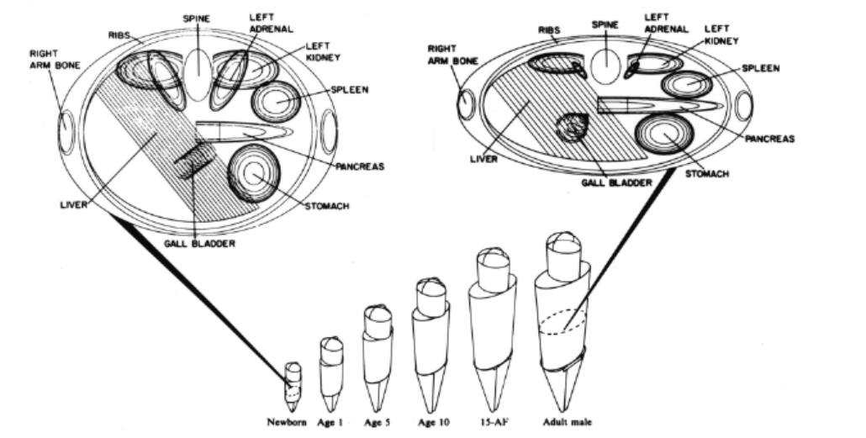
Cristy & Eckerman (1987) phantoms
The series contain six different phantoms:
  Adult (Male), 15-year (Adult female), 10-year 5-year , 1-year-old and newborn.
Has predefined organ/tissue densities and masses.
S-values for:
  25 target regions
  25 source regions

Slide 18
Phantoms
The phantom for the adult male was constructed to represent the Reference Person given in ICRP publication 23.
This is one of reasons why the results only are valid for populations and not for individuals.

Slide 19
Phantoms
Calculations with phantoms are made under the assumption that the activity is distributed homogeneously in the source regions.
  A mean absorbed dose is calculated
  Dose to target tissue is calculated

Slide 20
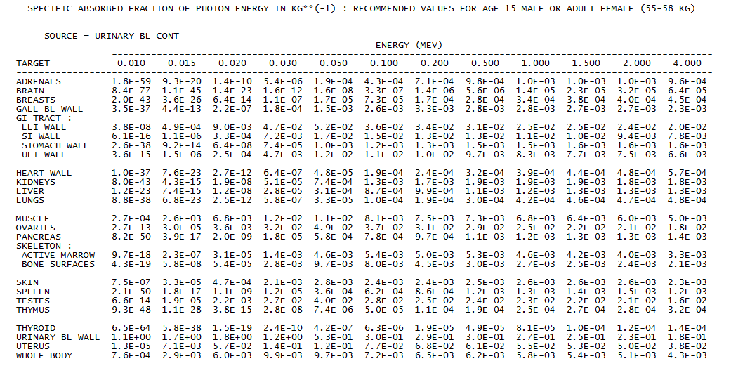

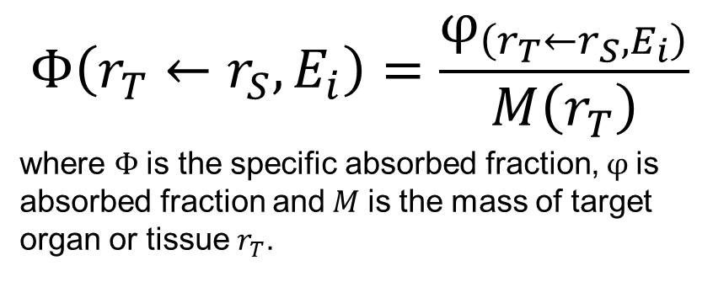
Specific absorbed fraction ($Φ$)
Tables are available which provide values of the specific absorbed fraction, i.e. the absorbed fraction per mass of the target organ.
$$Φ\left(r_{T}←r_{S},E_{i}\right)=\frac{φ_{\left(r_{T}←r_{S},E_{i}\right)}}{M\left(r_{T}\right)}$$
where $Φ$is the specific absorbed fraction, $φ$is absorbed fraction and$M$is the mass of target organ or tissue $r_{T}$.

Slide 21
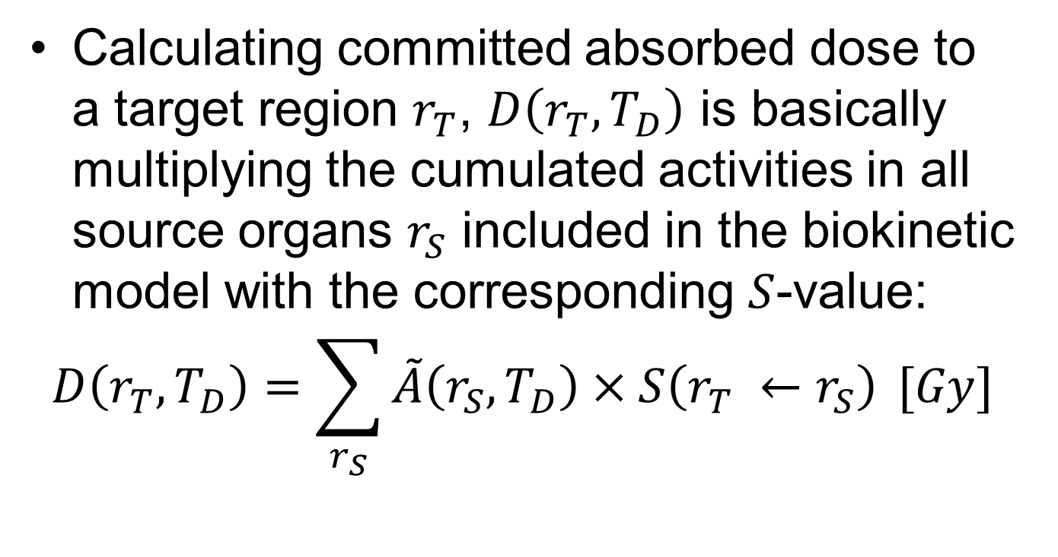
Absorbed dose
Calculating committed absorbed dose to a target region $r_{T}$, $D\left(r_{T},T_{D}\right)$ is basically multiplying the cumulated activities in all source organs $r_{S}$ included in the biokinetic model with the corresponding $S$-value:
$$D\left(r_{T},T_{D}\right)=\sum_{r_{S}}{\tilde{A}\left(r_{S},T_{D}\right)×S\left(r_{T} ←r_{S}\right)} [Gy]$$

Slide 22
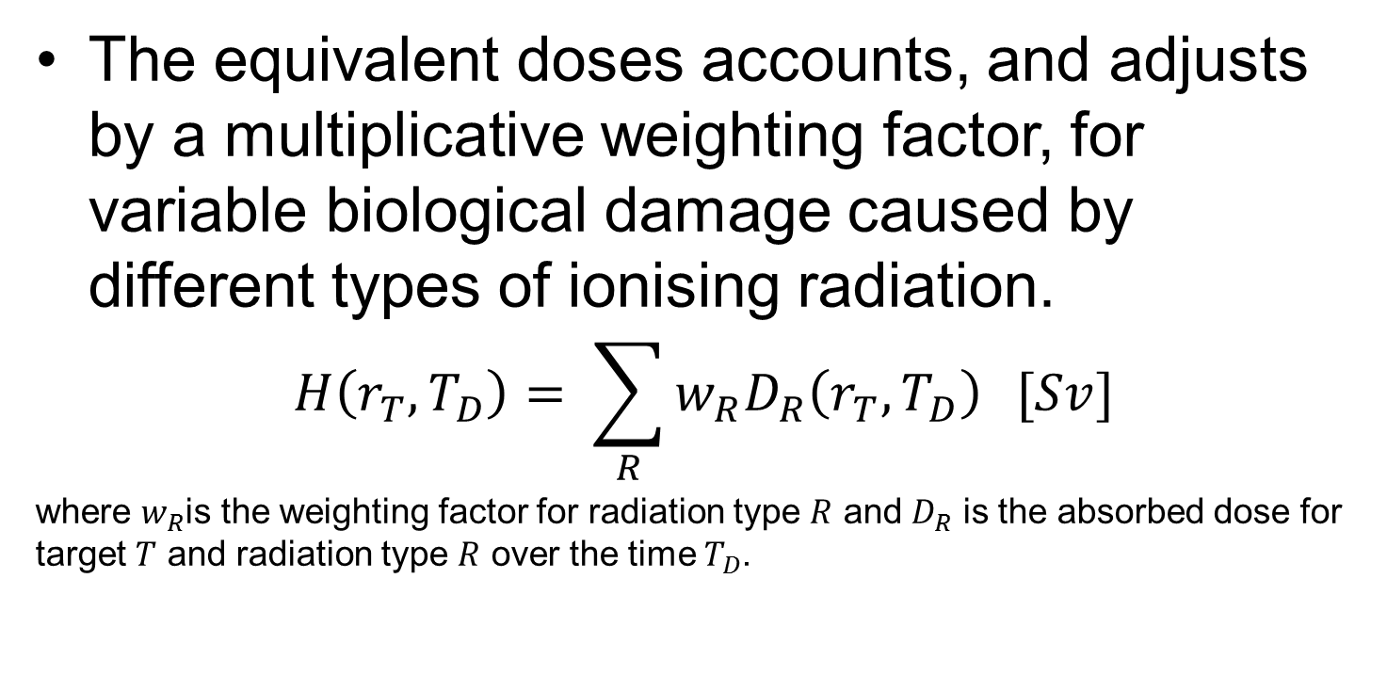

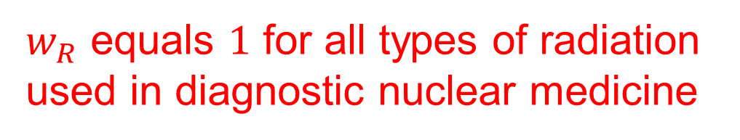
Equivalent dose ${H(r}_{T}, T_{D})$
The equivalent doses accounts, and adjusts by a multiplicative weighting factor, for variable biological damage caused by different types of ionising radiation.
$$H\left(r_{T},T_{D}\right)= \sum_{R}{w_{R}D_{R}\left(r_{T},T_{D}\right)} [Sv]$$
where $w_{R}$is the weighting factor for radiation type $R$ and $D_{R}$ is the absorbed dose for target $T$ and radiation type $R$ over the time $T_{D}$.
$w_{R}$ equals $1$ for all types of radiation used in diagnostic nuclear medicine

Slide 23

Effective dose ($E$)
Effective dose is a whole-body quantity obtained by summing equivalent does to organs and tissues weighted to take account of their contributions to overall stochastic risk (mainly cancer)
  the overall average lifetime risk of fatal cancer from uniform whole-body irradiation is estimated as 5% per Sv
  a linear non-threshold dose-response relationship is assumed for radiological protection purposes extrapolated down to low doses from doses at which effects are observable (thus doses are additive)
  For the exposure of children and adolescents, the risk would be higher, perhaps by a factor of two or three
  For the exposure of elderly, the risk would be lower by a factor of three to ten

Slide 24
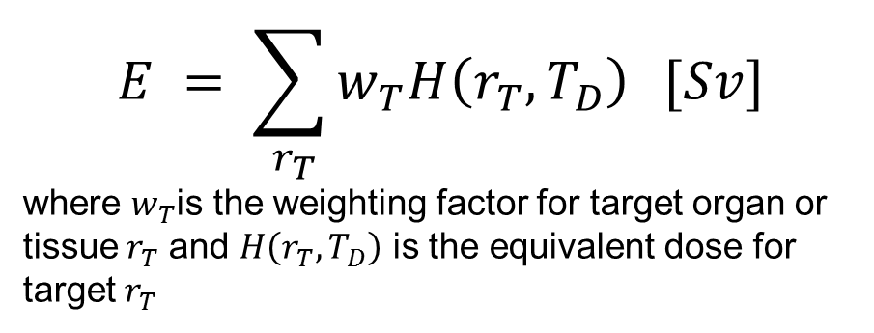

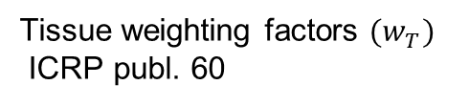
Effective dose ($E$)
Organs and tissues differ in their sensitivity per Sv to cancer induction.
  these differences are taken into account using tissues weighting factors.
$$E = \sum_{{ r}_{T}}{w_{T}H\left(r_{T},T_{D}\right)} [Sv]$$
where $w_{T}$is the weighting factor for target organ or tissue${ r}_{T}$ and $H\left(r_{T},T_{D}\right)$ is the equivalent dose for target${ r}_{T}$
Tissue weighting factors $(w_{T})$
ICRP publ. 60

Slide 25
Recap - what have we learned?
How to calculate time-integrated activities.
How S-values are generated and how to use them.
How to calculate absorbed dose for target organ or tissue.
How to calculate the equivalent (H_{T}) dose and effective dose (E).
Doses are calculated using reference phantoms and associated risk factors are populations averages.

Slide 26
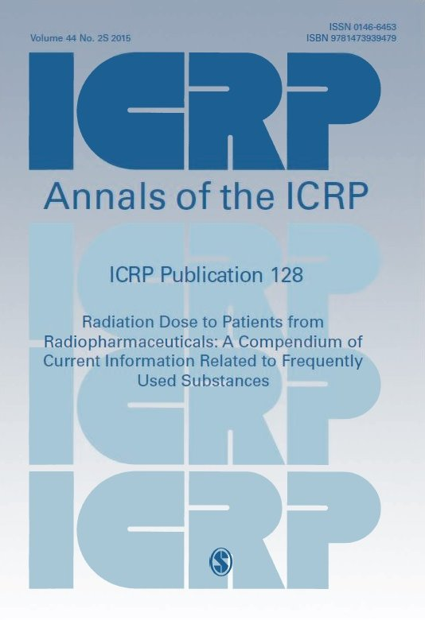
Now to the data in Pub. 128
Recommended reference format for citations
ICRP, 2015. Radiation Dose to Patients from Radiopharmaceuticals: A Compendium of Current Information Related to Frequently Used Substances. ICRP Publication 128. Ann. ICRP 44(2S).

Slide 27
Presentation of data
Radiopharmaceuticals are presented in three subsections:
Biokinetic model
Biokinetic data
Absorbed doses

Slide 28
Biokinetic model
The biokinetic model summarises what is published on the substance and the information about the organs and tissues included in ICRP’s biokinetic model (excretion, absorption, etc...).
Unless otherwise stated, all models refer to intravenous administration.

Slide 29
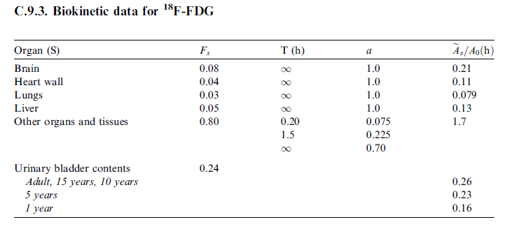
Biokinetic data
The biokinetic data is the biokinetic process expressed in figures.
Cumulated activity in organ or tissue S per unit of administered activity
Biokinetic data

Slide 30
Biokinetic data- Organ (S)
Source organ or tissue (S)
Excretion from organs to the bladder using ICRP’s age dependent kidney-bladder model
¹⁸F-FDG has a model, including five source organs where two fractions in “other organs and tissues” (remainder) have finite half-times and result in urinary excretion.

Slide 31
Biokinetic data - F_{S}
Fractional distribution to organ or tissue S
Fractional distribution (F_{S}) is the relative fraction that are assumed to be taken up by the organ or tissue S at the injection time, F_{S} for urinary bladder is 0.24 because the excretion from “Other organs and tissues” is 30% (0.8 x 0.3 = 0.24).

Slide 32
Biokinetic data – T(h)
Biological half-time for an uptake or elimination component T(h)
The biological half-time T(h) represent each components individual uptnation. For ¹⁸F-FDG, there are two components with elimination times of 0.22 h and 1.5 h that result in urinary excretion.

Slide 33

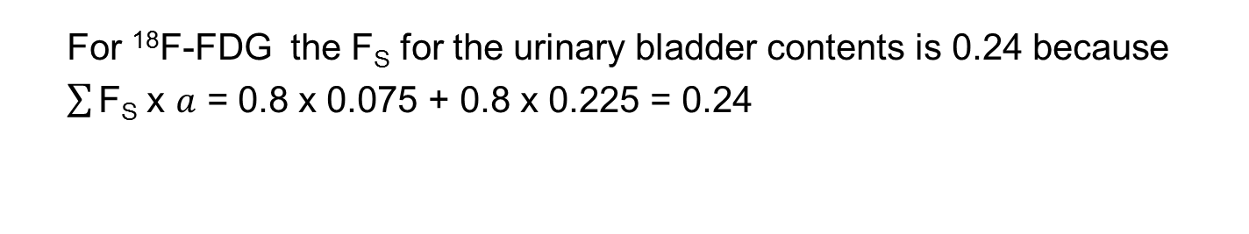
Biokinetic data – $a$
a is the fraction of F_{S} taken up or eliminated with the corresponding half-time.
A negative fraction indicates uptake and a positive indicates elimination. For an organ or tissue both the negative and the positive fractions must separately summarise to 1.
For ¹⁸F-FDG the $\text{F}\text{S}$ for the urinary bladder contents is 0.24 because
$\sum{\text{F}\text{S}}$ x $a$ = 0.8 x 0.075 + 0.8 x 0.225 = 0.24

Slide 34
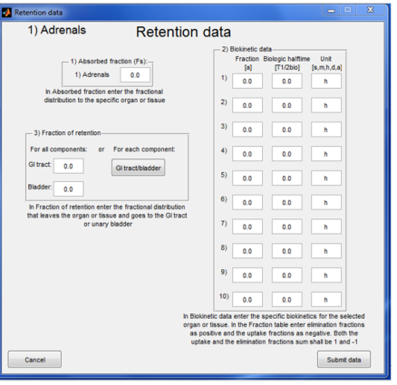

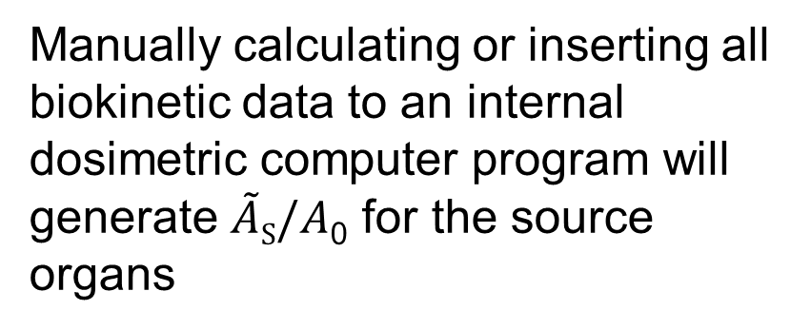
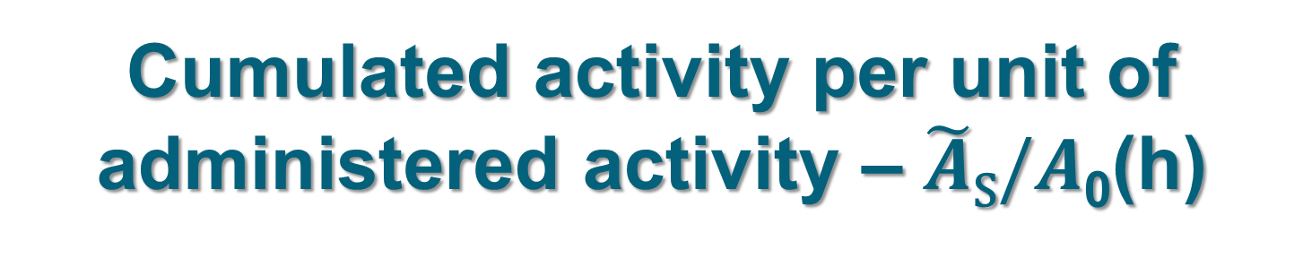
Cumulated activity per unit of administered activity – $\tilde{A}$_{S}$/A$₀(h)
=
Manually calculating or inserting all biokinetic data to an internal dosimetric computer program will generate $\tilde{A}$_{S}$/A$₀ for the source organs
ICRP uses the computer program IDAC to calculate $\tilde{A}$_{S}$/A$₀

Slide 35
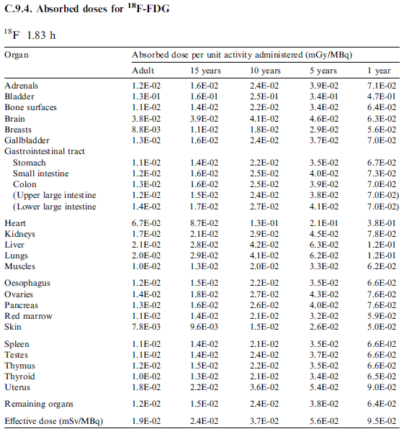

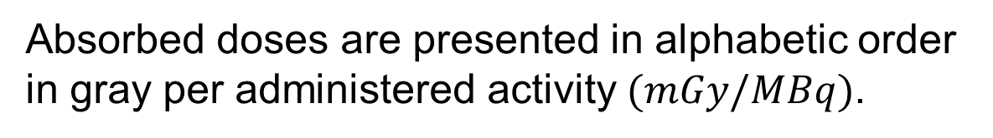
Absorbed doses ($Gy$)
The results of previous slides have led up to a user friendly table to calculate absorbed dose and effective dose
Absorbed doses are presented in alphabetic order in gray per administered activity $(mGy/MBq)$.

Slide 36

Effective dose ($mSv/MBq$)
Tissue weighting factors used in the calculation of effective doses are applied to all age groups.

Slide 37
Thank you
You are invited to use this lesson for training and to apply them in practice but not for commercial purposes.
good luck enjoy reading Publication 128!

Slide 38

www.icrp.org

