Slide 1
HOW TO PROTECT YOUR HANDS IN NUCLEAR MEDICINE WORK
ICRP Publication 106 Annex E
The membership of the Working Party that prepared Annex E of ICRP Publication 106 was:
J. Liniecki (Chair) J. Jankowski C. Martin S. Mattsson
Author for educational slides on behalf of ICRP
S. Carlsson, M. Andersson

Slide 2
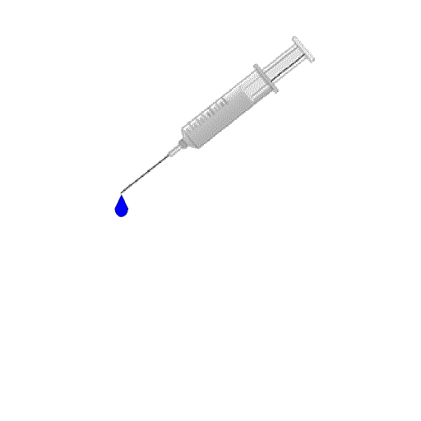

Sources of exposure
Exposure from external sources (vials, syringes)
Contamination (dispensing, administration)
Slides 2-5 refer to chapter E.1

Slide 3
Radionuclides in diagnosis: planar and SPECT
Nuclide | T_{1/2} | Decay mode (% abundance) | Photo emission (keV) (% abundance)
⁶⁷Ga | 3.7 d | EC (100) | 93 (39 %); 185 (21 %); 300 (17 %)
⁷⁵Se | 119.7 d | EC (100) | 265 (59 %); 136 (58 %); 280 (25 %)
^{99m}Tc | 6.0 h | IT (100) | 141 (89 %)
¹¹¹In | 2.8 d | EC (100) | 245 (94 %); 171 (91 %)
¹²³I | 13.3 h | EC (100) | 159 (83 %); 529 (1.4 %)
¹³¹I | 8.0 d | B- (100) | 364 (82 %); 637 (7 %)
²⁰¹Tl | 72.9 h | EC (100) | 167 (10 %); 69-80 (several X-rays)
Nuclide data from ICRP Publication 107

Slide 4
Radionuclides in diagnosis: PET
Nuclide | T_{1/2} (min) | Decay (% β⁺ ) | β⁺ Energy (MeV) Max. Mean |  | Range in water (mm) Max. Mean
¹⁸F | 109.77 | 96.7 | 0.6335 | 0.2498 | 2.4 | 0.6
⁶⁴Cu | 762 | 17.41 | 0.6531 | 0.2782 | 2.9 | 0.64
¹¹C | 20.39 | 99.77 | 0.9602 | 0.3856 | 4.1 | 1.1
¹³N | 9.97 | 99.8 | 1.1985 | 0.4918 | 5.1 | 1.5
¹⁵O | 2.037 | 99.9 | 1.732 | 0.7354 | 7.3 | 2.5
⁷⁵Br | 96.7 | 73.0 | 2.01 | 0.719 | 8.4 | 2.6
⁶⁸Ga | 67.7 | 88.9 | 1.8991 | 0.8329 | 8,2 | 2.9
¹²⁴I | 6013 | 11.7 10.8 | 1.5323 2.1376 | 0.6871 0.9748 | 6.3 8.7 | 2.3 3.5
⁶²Cu | 9.67 | 97.81 | 2.926 | 1.313 | 11.9 | 5.0
⁸²Rb | 1.27 | 81.8 13.1 | 3.379 2.5795 | 1.534 1.167 | 14.1 10.5 | 5.9 4.3
⁸⁶Y | 884 | 11.9 5.6 | 1.2535 3.141 | 0.535 0.681 | 5.2 12,7 | 1.8 2.9
⁶⁶Ga | 569 | 55.3 | 4.153 | 1.739 | 16.7 | 7.4
Nuclide data from ICRP Publication 107

Slide 5
RADIONUCLIDES IN THERAPY
Nuclide | T_{1/2} | E_{max} (MeV) and type of decay | Accompanying gamma-emission (keV)
β⁻ -emitters
³²P | 14.3 d | 1.7 (β⁻) | -
⁸⁹Sr | 50.5 d | 1.5 (β⁻) | -
⁹⁰Y | 2.7 d | 2.3 (β⁻) | -
¹³¹I | 8.0 d | 0.8 (β⁻) | 364 (82 %); 637(7 %)
¹⁵³Sm | 1.9 d | 0.8 (β⁻) | 103 (30 %)
¹⁷⁷Lu | 6.6 d | 0.5 (β⁻) | 208 (11 %); 113 (6 %)
¹⁸⁶Re | 3.7 d | 1.1 (β⁻) | 137 (9 %)
¹⁸⁸Re | 0.7 d | 2.1 (β⁻) | 155 (16 %)
α-emitters
²¹¹At | 7.2 h | 5.9 (α) | -
²¹²Bi | 1.0 h | 6.1 (α) | 727 (7 %)
²²³Ra | 11.4 d | 5.87 (α) | 269 (14 %);154 (6 %)
²²⁵Ac | 10.0 d | 5.8 (α)
Auger electron emitters
⁶⁷Ga | 3.3 d | Auger electrons | 93 (39 %); 185 (21 %); 300 (17 %)
¹²⁵I | 59.4 d | Auger electrons | 35 (6.7 %)
^{195m}Pt | 4.0 d | Auger electrons | 99 (11 %)
Nuclide data from ICRP Publication 107

Slide 6
APPLY ICRP BASIC SYSTEM OF RADIATION PROTECTION
(JUSTIFICATION)
OPTIMISATION APPLIED TO WORKING PROCEDURES
DOSE LIMITATION
Slide refer to chapter E.9

Slide 7
DOSE LIMITATION
Annual equivalent dose
Skin 500 mSv averaged over 1cm²
Hands and feet 500 mSv
Slides 7-13 refer to chapter E.4
Image: ICRP Publication 103

Slide 8
Dose limits can easily be exceeded
The equivalent dose-rate to the unprotected fingers holding a vial containing 2 GBq ¹⁸F is in the order of 200 μSv/s. If we assume that the content is dispensed to 3 patients and the time required is 10s per procedure, then the total dose to the fingers of the worker will be 4 mSv. If the procedure is repeated 5 days per week and 45 weeks per year the annual equivalent dose will be 900 mSv.
Assume an activity of 40 GBq ^{99m}Tc in a volume of 10 ml. One microdrop (20µl) of the solution will then contain an activity of 80 MBq. If spread over 10 mm² on the skin the initial dose rate will be about 2000 mSv/h. If not removed the cumulative dose will be 17 Sv over the 10 mm² area, i.e. 1700 mSv averaged over 1 cm², which exceeds the dose limit of 500 mGy.

Slide 9
Dose rate at contact
Contact of an unshielded (5 ml) syringe
(Carnicer, A. et al. Occupational Exposure: With Special Reference to Skin Doses in Hands and Fingers. In Radiation Protection in Nuclear Medicine (Ed) Mattsson, S. Hoeschen,C. Springer 2013)

Slide 10
Time
Dose is proportional to
the time exposed
Experienced workers will generally but not necessarily have lower exposure of the hands.
TRAINING IS ESSENTIAL!!
Dose = Dose-rate x Time

Slide 11
Dose rate at contact
Contact of an unshielded (5 ml) syringe
Time (min) to reach 500 mSv
(Carnicer, A. et al. Occupational Exposure: With Special Reference to Skin Doses in Hands and Fingers. In Radiation Protection in Nuclear Medicine (Ed) Mattsson, S. Hoeschen,C. Springer 2013)

Slide 12
Protection measures to reduce (optimise) external exposure of hands
Shielding
Time (training)
Distance

Slide 13

Distance
Inverse square law (ISL):
Dose-rate $∝$ 1/(distance)²
Meaning that if the distance doubles will the dose rate is reduced to one quarter.
Relative distance

Slide 14
Syringe shield
Not shielded
0.4 mSv/h
0.8 mSv/h
4.2 mSv/h
22 mSv/h
8 mSv/h
Shielded (2 mm W)
0.004 mSv/h
0.01 mSv/h
0.04 mSv/h
0.16 mSv/h
6 mSv/h
400 MBq Tc-99m in 1 ml
Slides 14-23 refer to chapter E.5

Slide 15
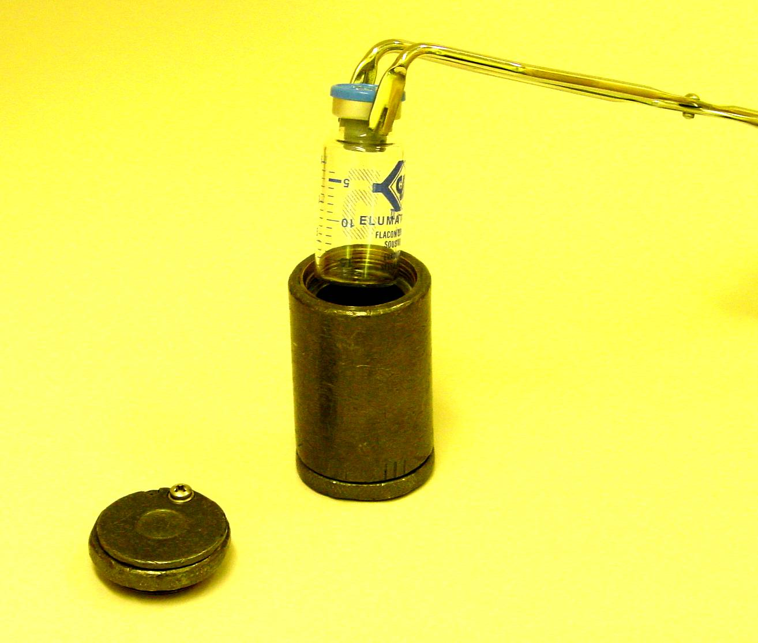
Vial shield
^{99m}Tc
10 GBq
10 ml
560 mGy/h
1 mGy/h
2 mm lead

Slide 16
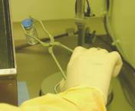
RECOMMENDATION
Never touch an unshielded source with your hands
Use long tweezers for handling of sources

Slide 17
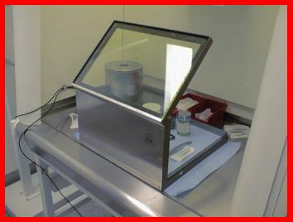
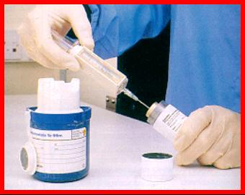
SHIELDING OF SOURCES
Factors affecting the design:
Radionuclide (type and energy
of emitted radiation)
activity
shielding material

Slide 18
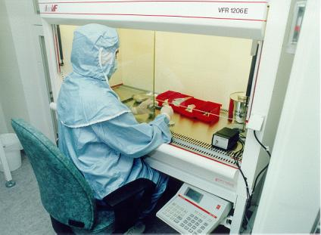
Shielding
Bench top shield
Vial shields
Syringe shields
Note:The full garment in the photo is for aseptic or good manufacturing purposes and not necessarily for radiation protection

Slide 19
DEFINITIONS
Dose rate constant
The dose rate , Γ(μSv/h), at 1 m from a point source of 1 MBq
TVL
Tenth value layer, which is the thickness of a material that reduces the number of incident photons by a factor of 10.

Slide 20
SPECIFIC DOSE-RATE CONSTANT (Γ) FOR SOME RADIONUCLIDES AND THE TENTH VALUE LAYER OF LEAD.
DATA FROM LM UNGER & DK TRUBEY, SPECIFIC GAMMA-RAY DOSE CONSTANTS FOR NUCLIDES IMPORTANT TO DOSIMETRY AND RADIOLOGICAL ASSESSMENT, OAK RIDGE NATIONAL LABORATORY, ORNL/RSIC-45/R1 (1982)
SHIELDING CALCULATIONS
Radionuclide | Γ (μSvh⁻¹MBq⁻¹) | TVL (mm lead)
F-18 | 0,1851 | 13.5
Cr-51 | 0,0063 | 6.0
Co-57 | 0.0409 | 0.57
Ga-67 | 0,0300 | 4.8
Se-75 | 0,2323 | 2.5
Mo-99 | 0,0305 | 19.7
Tc-99m | 0,0332 | 0.83
In-111 | 0,1356 | 2.23
I-123 | 0,0748 | 1.19
I-125 | 0,0743 | 0.06
I-131 | 0,0764 | 9.5
Sm-153 | 0,0244 | 0.32
Tl-201 | 0,0236 | 0.88

Slide 21
EXAMPLE 1
Estimate the thickness of a lead container for 30 GBq
of ^{99M}Tc. Dose rate at 1 m should be 2 μSv/h
Dose rate constant: 0.017 μSv/(h*MBq)
TVL: 0.9 mm lead
Dose rate for unshielded source: 0.017 μSv/(h*MBq) * 30000 MBq = 510 μSv/h
Reduce exposure 255 times which equals:
ln(255)/ln(10) = 2.4 TVL = 2.2 mm lead.

Slide 22
EXAMPLE 2
What thickness of lead is required to reduce the exposure rate to 20 μSv/h at 1 m for a container designed to store 15 GBq ¹³¹I?
According to table Γ=0.0764 μSvh⁻¹MBq⁻¹ for ¹³¹I which means that the unshielded dose rate at 1 m will be 15000x0.0764=1146 μSvh⁻¹ . The shield should then be designed to reduce the dose-rate a factor of 1146/20=57.3. which will be achieved by ln(57.3)/ln(10)=1.76 * TVL From table we learn that TVL for I-131 is 9.5 mm. Hence, a shield thickness of 1.76*9.5=16.7 mm of lead is required.

Slide 23
EXAMPLE 3
A vial containing 2 GBq ¹⁸F is put in a 2 mm lead shield generally used for ^{99m}Tc sources. How much will this shield reduce the dose-rate at the surface?
According to table TVL for ¹⁸F is 13.5 mm lead. Then the attenuation coefficient will be ln(10)/TVL=0.1706 mm⁻¹. Assuming monoexponential attenuation, the dose-rate (D) will be reduced to: D/D₀=exp(-0.1706*2)=0.71 of the unshielded dose-rate (D₀).
This example shows the importance of selecting shields aimed for the source to use.

Slide 24
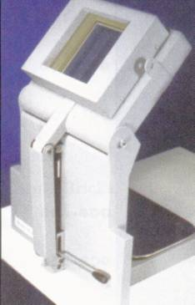
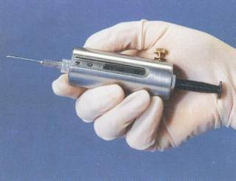
SHIELDING IN PET
Protection against high energy
photons requires lead and lead glass
shield of significant thickness (cm)
Biodex Medical
Slide refer to chapter E.8

Slide 25
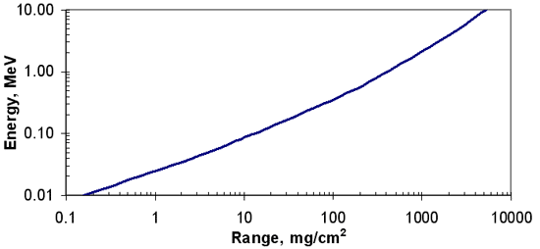
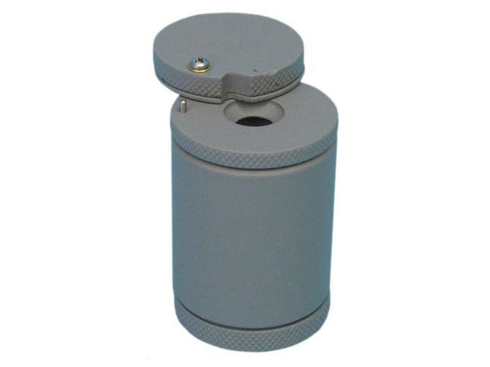
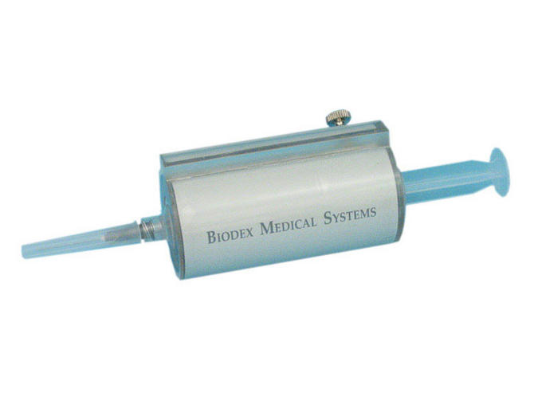
SHIELDING AGAINST HIGH ENERGY β-PARTICLES
⁹⁰Y
Max energy 2.3 MeV
Polymetylmetakrylat (PMMA) density 1188 mg/cm3 Maximum range ≈1 cm
Bremsstrahlung is generated in the source and PMMA.
In conclusion:
Use 1 cm of PMMA with an external layer of a few mm of lead in vial and syringe shields.
Take home message:
The low z material stops beta and the high z material stops the created photons from the beta.
Slides 25-27 refer to chapter E.7

Slide 26
THE EFFECT OF SHIELDING
Procedures | Shield | Shielding efficiency
^{99m}Tc preparation | Yes No | 4.3
^{99m}Tc administration | Yes No | 1.8
¹⁸F preparation | Yes No | 2.3
¹⁸F administration | Yes No | 5.0
⁹⁰Y-Zevalin® preparation | Yes No | -
⁹⁰Y-Zevalin® administration | Yes No | 3.1
(Carnicer, A. et al. Occupational Exposure: With Special Reference to Skin Doses in Hands and Fingers. In Radiation Protection in Nuclear Medicine (Ed) Mattsson, S. Hoeschen,C. Springer 2013)

Slide 27
Summary shielding recommendations
For the injection (syringe shielding):
2 mm W (or Pb) for ^{99m}Tc give a dose reduction of at least 2 order of magnitudes.
5 mm W provides up to a factor 10 in dose reduction for ¹⁸F (8 mm W up to a factor 40).
For ⁹⁰Y 10 mm PMMA completely shield beta radiation, nevertheless 5 mm shielding of tungsten provides a better shielding cutting down bremsstrahlung radiation too.
For the preparation (vial shielding):
For ¹⁸F, 3 cm of Pb provides 2 order of magnitudes on dose reduction. The same attenuation for ^{99m}Tc is obtained with 2 mm Pb.
For ⁹⁰Y an acceptable shielding is obtained with 10 mm PMMA with an external layer of few mm of lead or alternatively 5 mm of W.
For ¹³¹I, 2 cm of Pb provides 2 order of magnitudes on dose reduction
(Carnicer, A. et al. Occupational Exposure: With Special Reference to Skin Doses in Hands and Fingers. In Radiation Protection in Nuclear Medicine (Ed) Mattsson, S. Hoeschen,C. Springer 2013)

Slide 28
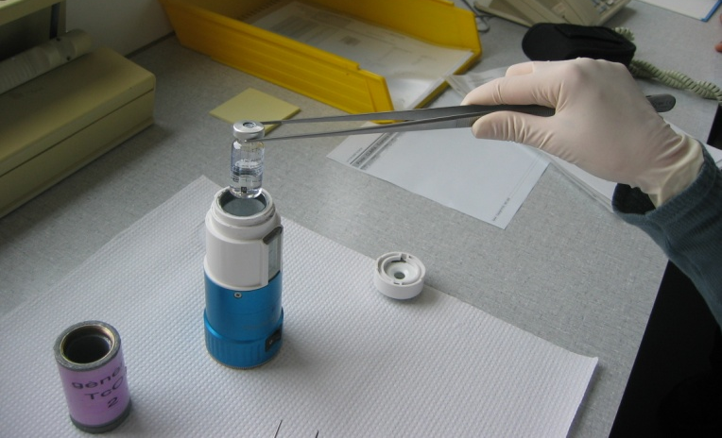
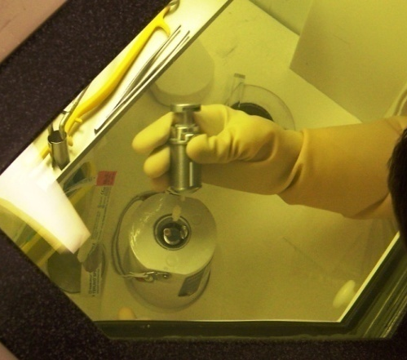
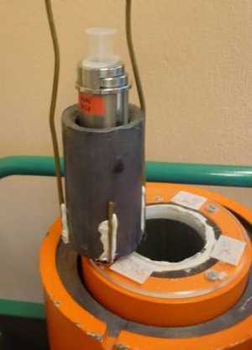
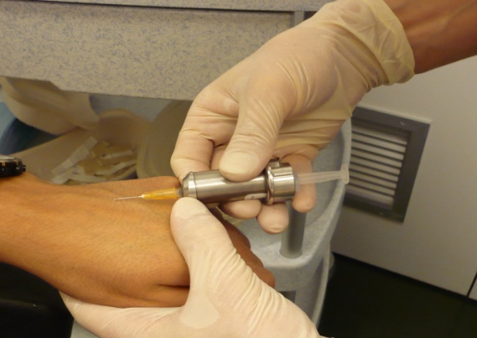
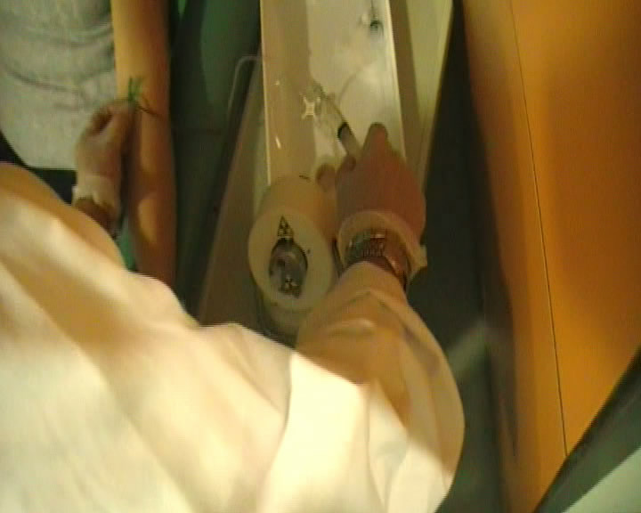
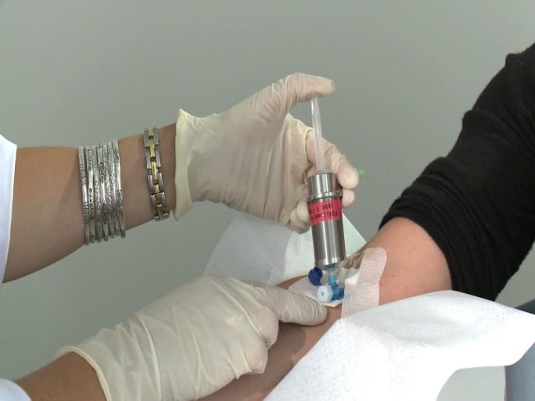
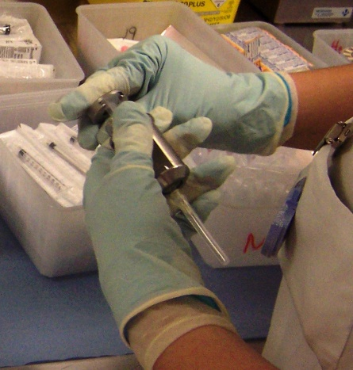
Examples of good working procedures
Preparation of ^{99m}Tc
Preparation of ¹⁸F
Administration of ^{99m}Tc
Administration of ¹⁸F
(Carnicer, A. et al. Occupational Exposure: With Special Reference to Skin Doses in Hands and Fingers. In Radiation Protection in Nuclear Medicine (Ed) Mattsson, S. Hoeschen,C. Springer 2013)
Slides 28-29 refer to chapter E.3

Slide 29
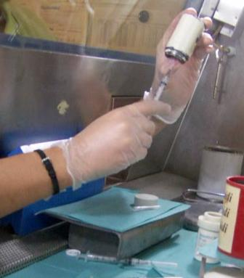
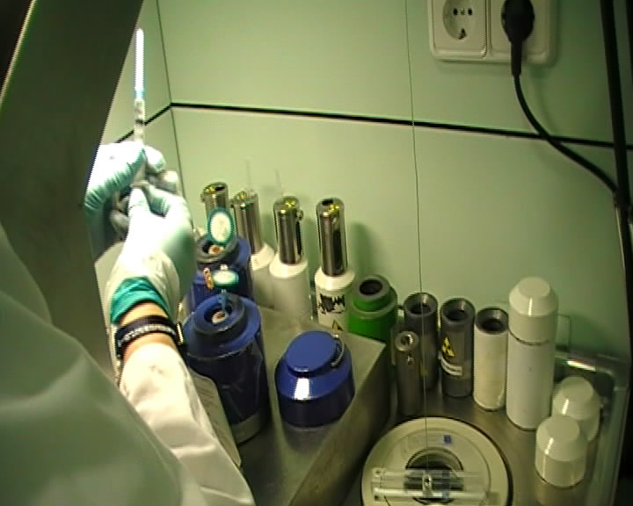
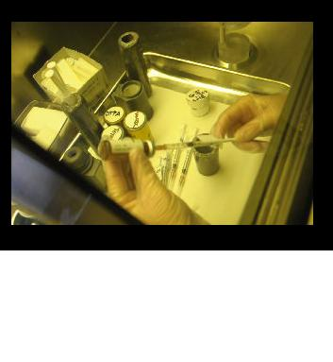
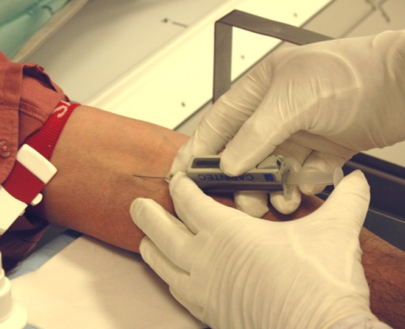
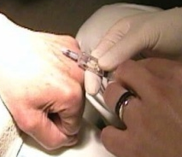

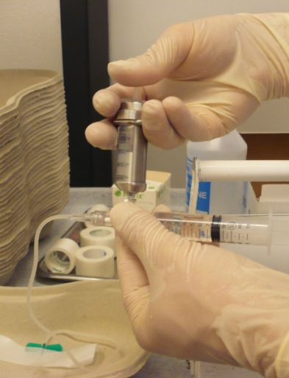
Examples of bad working procedures
Preparation of ^{99m}Tc
Preparation of ¹⁸F
Unshielded vial and syringe
Unshielded syringe, thumb directly exposed
Unshielded syringe
Administration of ^{99m}Tc
Administration of ¹⁸F
Unprotected fingertips
Unshielded syringe
Left hand holding the part of the needle
Unshielded syringe
(Carnicer, A. et al. Occupational Exposure: With Special Reference to Skin Doses in Hands and Fingers. In Radiation Protection in Nuclear Medicine (Ed) Mattsson, S. Hoeschen,C. Springer 2013)

Slide 30
MONITORING EXTERNAL EXPOSURE
The operational quantity for external individual monitoring is the personal dose equivalent, Hp(d), which is the dose equivalent in ICRU soft tissue at an appropriate depth, d, below a specified point on the human body.
For skin, hands, and feet personal dose equivalent, Hp(0.07), a depth d=0.07 mm is used.
Slides 30-32 refer to chapter E.10

Slide 31
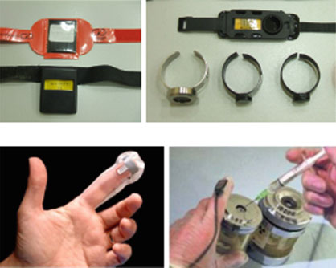
MONITORING EQUIPMENT
+ comfortable
delayed reading
+direct reading
- uncomfortable
Wrist TLD Ring TLD
Electronic extremity Electronic extremity dosimeter dosimeter

Slide 32
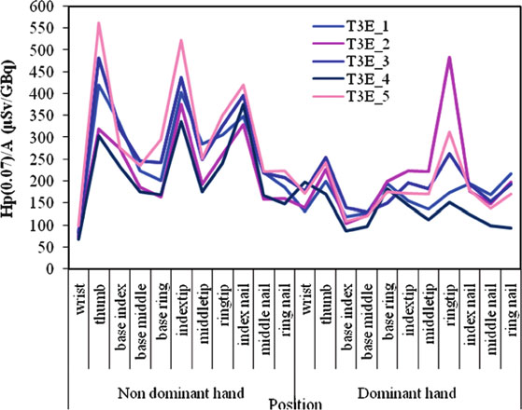
What to measure?
The maximum dose should be evaluated and tested for conformity with the dose limit
Hand dose distribution for worker T3E, for preparation of ¹⁸F. Each curve corresponds to individual sets of 22 TL readings.
(Carnicer, A. et al. Occupational Exposure: With Special Reference to Skin Doses in Hands and Fingers. In Radiation Protection in Nuclear Medicine (Ed) Mattsson, S. Hoeschen,C. Springer 2013)

Slide 33
WHERE TO MEASURE?
The most exposed part of the hands are likely to be the tips of the index and middle fingers and the thumb of the dominant hand.
Based on monitoring results it is recommended that a ring dosimeter should be worn on the middle finger of the dominant hand with the element on the palm side, and that a factor of three should be applied to derive an estimate of the dose to the tip (maximum dose and fraction of dose limit). When gloves are worn the ring dosimeter should be worn under the gloves. If the dosimeter element is worn facing the back side of the hand, a factor of six should be applied.
Slides 33-35 refer to chapter E.10

Slide 34
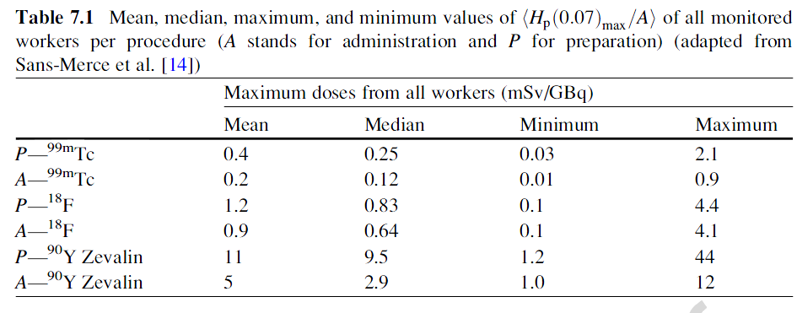
External exposure of hands
(Carnicer, A. et al. Occupational Exposure: With Special Reference to Skin Doses in Hands and Fingers. In Radiation Protection in Nuclear Medicine (Ed) Mattsson, S. Hoeschen,C. Springer 2013)

Slide 35
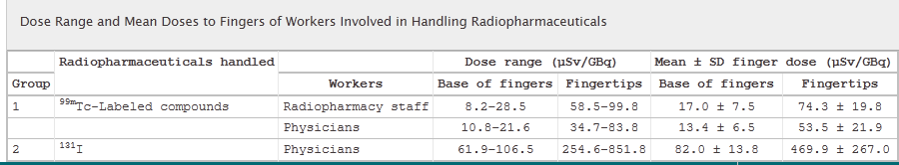
External exposure of hands
Figure shows that the dose is substantially higher to finger tips than the base of the fingers
Gauri S. Pant et. al., JNMT 2006

Slide 36
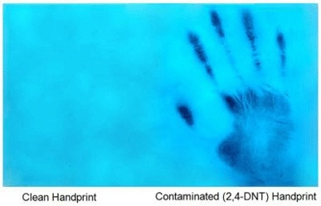
CONTAMINATION
Clean handprint Contaminated handprint

Slide 37
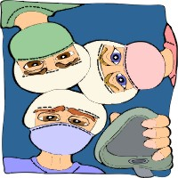

Contamination of the worker related to:
spills
drawing dose
administration of radiopharmaceutical
experimental work with animals
emergency surgery of a therapy patient
autopsy of a therapy patient
other accidents

Slide 38
CONTAMINATION
FROM PATIENT
Administered activity: 1000 MBq I-131
Excretion Concentration Contamination
Saliva <2 MBq/g utensils 2 kBq
Perspiration <20 Bq/cm² surfaces 10 Bq/cm²
Breathing 100 Bq/l air 1 Bq/l
Urine <500 kBq/ml toilet 2 kBq/cm²
Generally larger than the derived limits for contamination
given by ICRP (publ. 57)

Slide 39
Skin exposure by contamination
Skin contamination equivalent dose rate factors at a depth of 70 µm
Radionuclide | mSv-cm²/MBq-h | Radionuclide | mSv-cm²/MBq-h
¹⁴C | 305 | ⁹⁰Sr-⁹⁰Y (equilibrium) | 4272
¹⁸ F | 1900 | ^{99m}Tc | 243
²²Na | 1870 | ¹¹¹In | 376
²⁴Na | 2357 | ¹²³I | 365
³²P | 2397 | ¹²⁵I | 417
³⁵S | 332 | ¹³¹I | 1694
³⁶Cl | 2178 | ¹³⁷Cs-¹³⁷Ba (equilibrium) | 1941
⁴⁵Ca | 884 | ¹⁴⁷Pm | 612
⁵⁷Co | 78 | ¹⁵³Sm | 1600
⁵⁹Fe | 1283 | ¹⁹²Ir | 1592
⁶⁰Co | 1146 | ²⁰¹ Tl | 343
⁶⁷Ga | 324 | ²⁰⁴Tl | 1804
DELACROIX, D., GUERRE, J.P., LEBLANC, P., HICKMAN, C., Radionuclide and Radiation Protection Data Handbook 1998, Radiation Protection Dosimetry, Vol. 76 Nos. 1-2 1998.

Slide 40
Decontamination of skin
If contamination of the skin occurs, immediately the area should be thoroughly washed using mild soap and tepid (not hot) water. Particular care should be paid to cleaning under the fingernails. If this does not bring the contamination to an acceptably low level the procedure should be repeated. Scrub with a nail brush but take care not to break the skin.

Slide 41
DECONTAMINATION OF SKIN
Remaining activity (%)
Method
Substance 1 2 3 4
---------------------------------------------------------------------------------
^{99m}Tc-DTPA 1 0 1 1
^{99m}Tc-MDP 7 1 3 5
^{99m}Tc-pertechnetate 5 7 5 7
^{99m}Tc-colloid <1 <1 <1 <1
¹³¹I-Hippuran <1 <1 <1 <1
¹³¹I-iodide 8 5 <1 2
⁶⁷Ga-citrate 3 1 4 1
¹¹¹In-DTPA <1 <1 <1 <1
---------------------------------------------------------------------------------
1: 90 s in water, 2: 90 s in soap and water, 3: skin lotion
and 90 s in soap and water, 4: commercial decontamination
substance
IAEA, 2000. Training Material on Radiation Protection in Nuclear Medicine, Part 5. Occupational Exposure Protection of the Worker

Slide 42
Skin exposure by contamination
In 10 months 560 inspections were carried out. Local contamination was found on the fingers of nuclear medicine technologists in 40 cases. The measured activities ranged from 211 Bq/cm² to 460 kBq/cm², resulting in cumulated skin doses between 0.02 and 809 mSv.
(Covens P, et al Nucl Med Com 33, 2012)

Slide 43
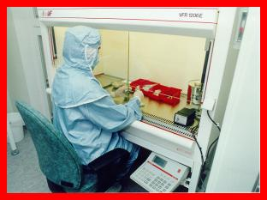
- adopt clean operating conditions
- adopt good laboratory practices
- do not eat, smoke etc…
- use nitrile or vinyl gloves (no latex) and protective clothing
To minimize contamination

Slide 44
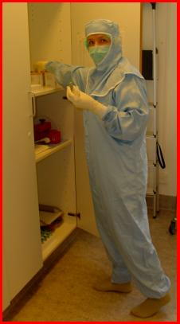
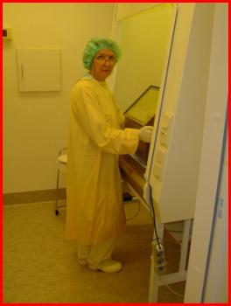
PROTECTIVE CLOTHING
Appropriate clothing should as a minimum include lab coat and gloves. National regulations may require more.
Notes:
The image to the right is an example of clothing if the preparation of radiopharmaceuticals have to be done in a sterile environment

Slide 45
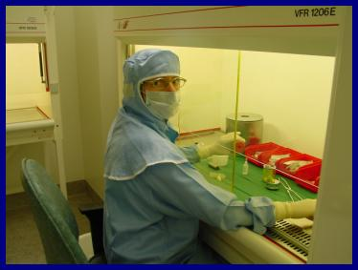
SAFETY EQUIPMENT (OPTIMISATION)
PREPARING AND DISPENSING RADIOPHARMACEUTICALS
Shields
Protective clothing
Tools for remote handling
of radioactive material
Shielded containers for radioactive
waste
Dose rate monitor with alarm
Contamination monitor
Decontamination kit
Signs, labels and records

Slide 46
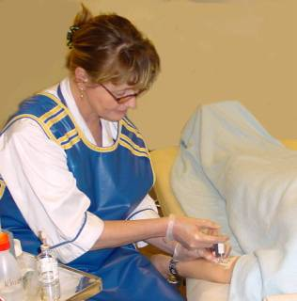
SAFETY EQUIPMENT
(OPTIMISATION)
ADMINISTRATION OF RADIOPHARMACEUTICALS
Syringe shield
Gloves
Lead apron
Absorbing pads

Slide 47
Recommendations (ICRP 106)
The dispensing protocol and the use of shielding devices in any radiopharmacy should be assessed carefully to optimise the strategy.
Shielding of the syringe is the most important factor affecting finger dose, and syringe shields should be used as much as possible.
Vials from which radioactive liquid is withdrawn should always be shielded.
The choice of manipulation technique only has a minor influence on finger dose; the most important factor is that staff are able to use the technique effectively.
All staff should undergo a period of intense training in which they practice manipulations using non-radioactive liquid prior to undertaking any dispensing of radioactive liquid.
Careful positioning of materials within the dispensing cabinet is important for streamlining the procedure and minimising doses to the hands.
Slides 47-49 refer to chapter E.11

Slide 48
Recommendations (ICRP 106)
The most exposed parts of the hands are likely to be the tips of the index and middle fingers, and the thumb of the dominant hand, with exposure for the index finger being highest.
Preliminary finger dose monitoring should be undertaken for any person handling >2 GBq/day, and regular monitoring should be carried out if doses to the most exposed part of the hand exceed 6 mSv/month.
The finger tip or most exposed part of the hand should be monitored wherever possible, particularly if the dose is likely to approach a dose limit.
If it is not possible to monitor the dose to the most exposed finger tip, an empirical multiplying factor may be applied to doses recorded by ring dosimeters worn on the middle finger of the dominant hand to estimate this dose. Factors of three or six should be used for the dosimeter element on the palm or back of the hand, respectively.
The dispensing technique should be reviewed to confirm that the positions where dosimeters are worn are the most appropriate.
For injections, prior venous cannulation allows the injection to proceed more rapidly; if the syringe is shielded, the dose to the hand of the nurse or physician will be kept to a minimum.

Slide 49
Recommendations (ICRP 106)
Significant doses can be received from a single administration of a therapy involving a high-energy beta-particle emitter, and the following precautions are recommended:
Administrations of beta-emitting therapy radiopharmaceuticals should be carefully planned.
5–10 mm thick PMMA syringe shields should always be used for administration of ⁹⁰Y or similar high-energy beta-emitting therapy radionuclides.
Close contact with any thin-walled vessel containing therapeutic levels of ⁹⁰Y should be avoided through the use of forceps or PMMA shielding.
Doses to the most exposed finger tips should be monitored directly for each session in which ⁹⁰Y or similar high-energy beta-emitting therapy radionuclides are administered.

Slide 50
Thank you
You are invited to use this lesson for training and to apply them in practice but not for commercial purposes.

Slide 51

www.icrp.org

